Slide 1
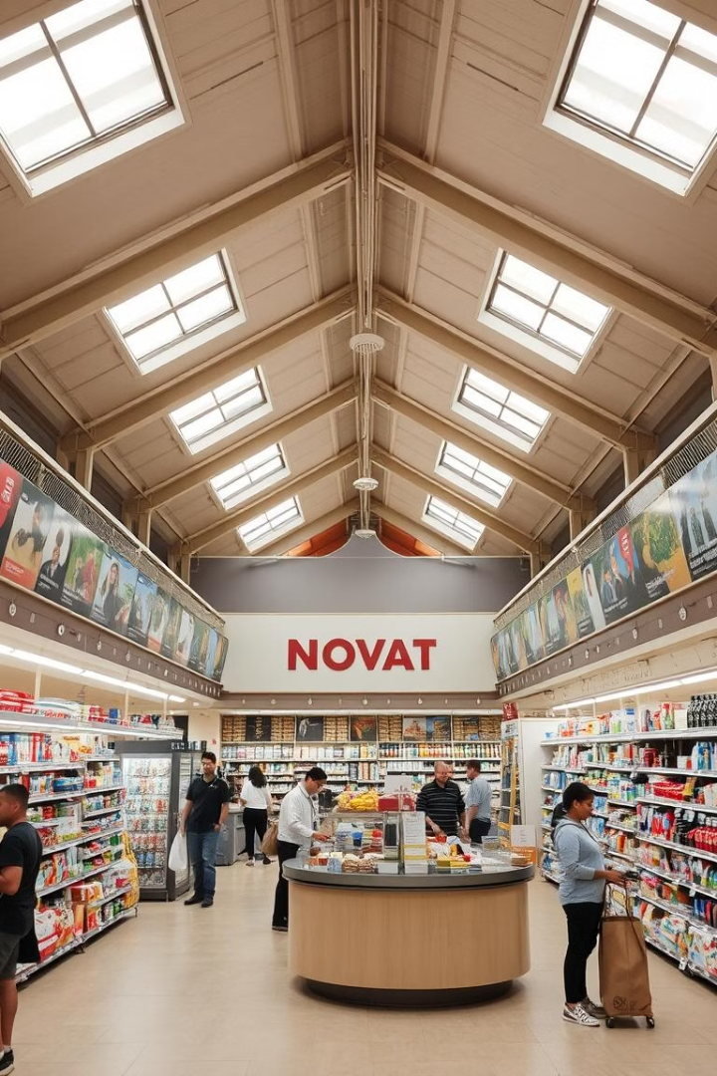

Nova Mart Diwali & Sankranti Campaign Analysis
Analyzing Nova Mart's promotional campaign data for Diwali and Sankranti to understand its impact and identify areas for improvement.
by Manideep Cheekoti

Slide 2
Campaign Overview
Diwali Campaign
Sankranti Campaign
Start Date: 20-10-2023
Start Date: 10-01-2024
End Date: 10-11-2023
End Date: 15-02-2024

Slide 3
Dataset Overview
Dataset
Description
Columns
dim_campaigns
Provides details about each promotional campaign, including its name, start and end dates.
campaign_id, campaign_name, start_date, end_date
dim_products
Contains information on all products sold, including their codes, names, and categories.
product_code, product_name, category
dim_stores
Lists the locations of all stores, along with their city and store IDs.
store_id, city
fact_events
The core sales data, linking products, campaigns, stores, and sales quantities before and after promotions.
event_id, store_id, campaign_id, product_code, base_price(before_promo), quantity_sold(before_promo), promo_type, base_price(after_promo), quantity_sold(after_promo)

Slide 4
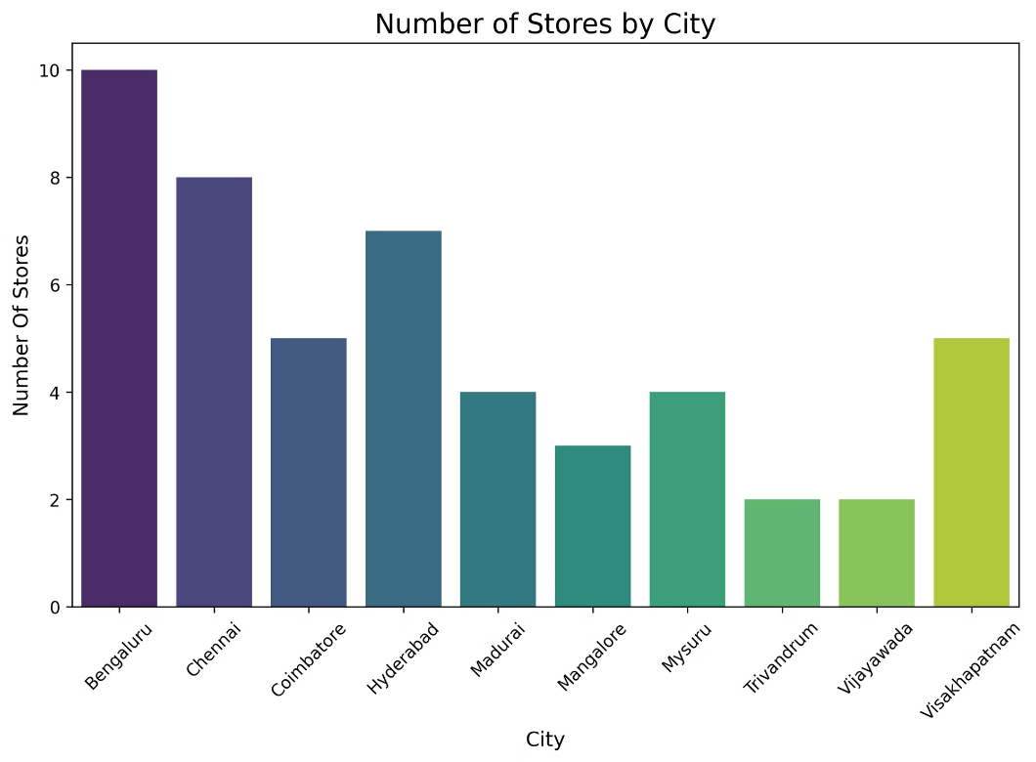
Campaign Reach & Distribution
Impact by City
Top Performing Cities
Bangalore
Chennai
Hyderabad
Bengaluru & Chennai
Trivandrum & Vijayawada
Key markets for the campaign
Limited store reach

Slide 5

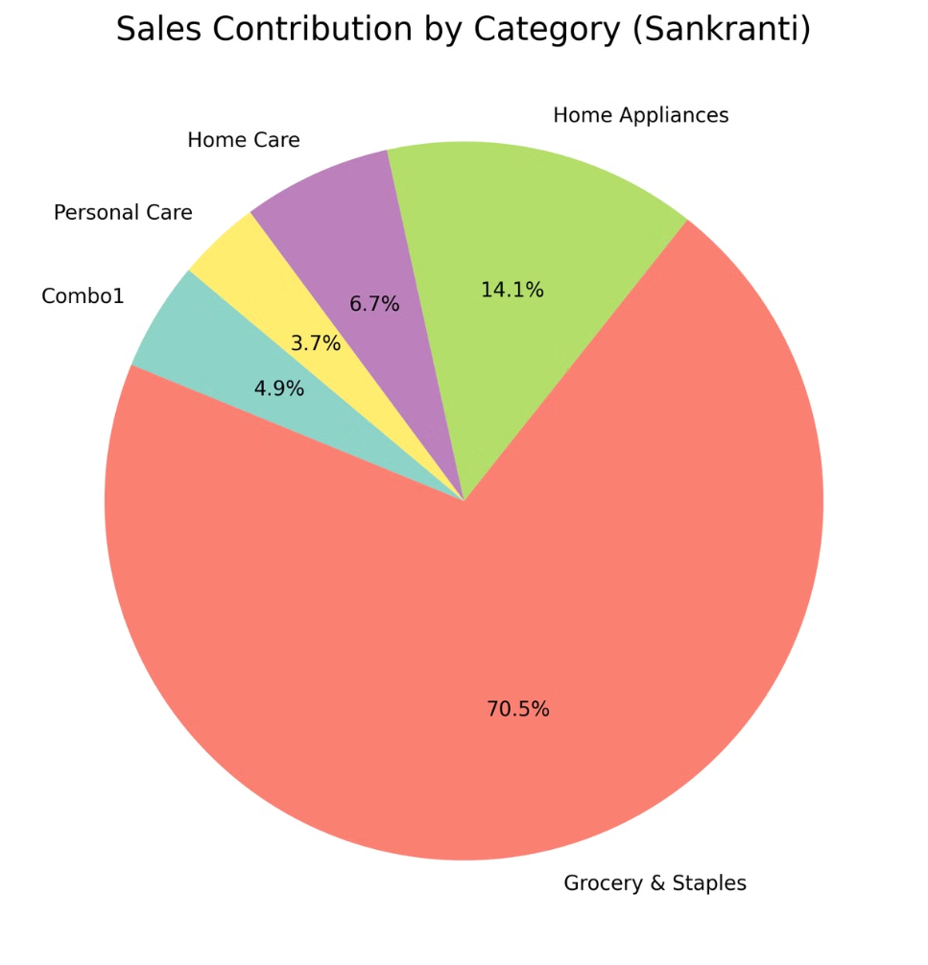
Sankranti Campaign Performance
1
Grocery & Staples
2
Personal Care & Home Appliances
Dominant category
Potential growth areas

Slide 6
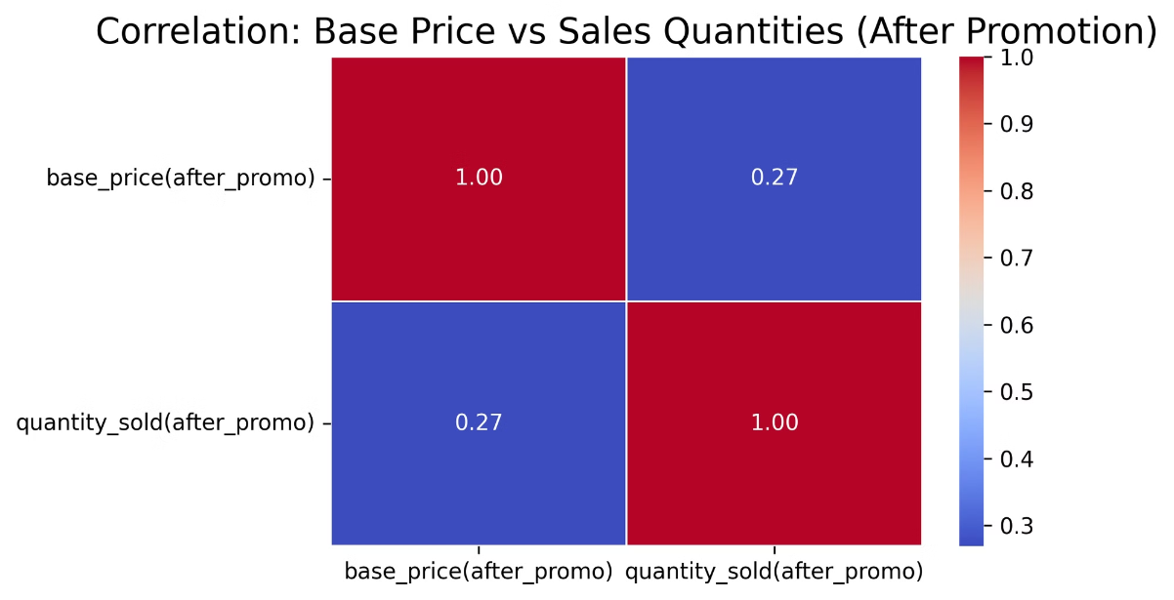


Price & Sales Correlation
Lower Base Price
1
Higher Sales Quantity
2
Strategic Pricing
Value & Promotions

Slide 7
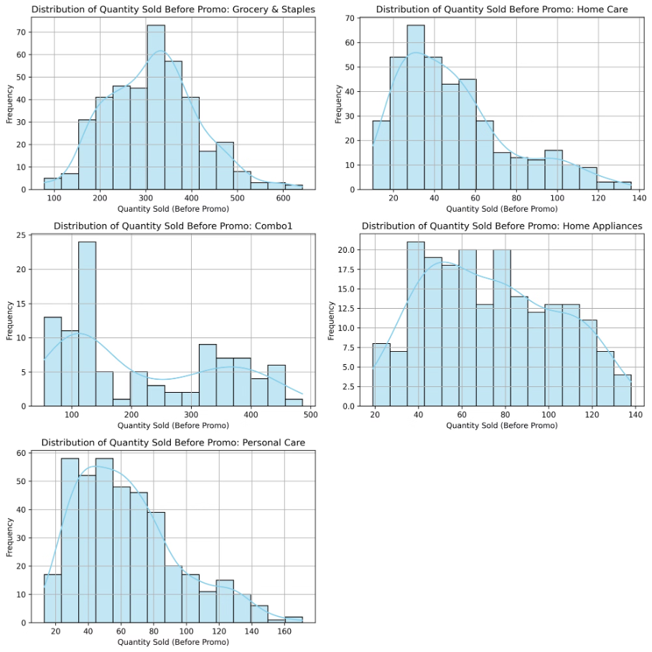

Campaign Performance by Category
Grocery & Staples
Consistent Demand
key driver of revenue growth
Home Care & Personal Care
Lower Pre-Promotion Sales
Require targeted strategies

Slide 8
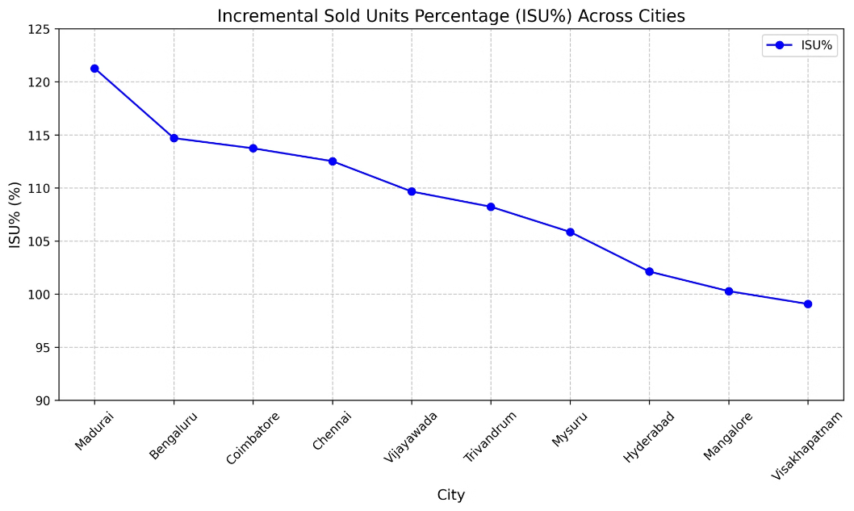
City-Specific Promotional Impact
1
Madurai
Highest ISU%
2
Visakhapatnam
Lowest ISU%

Slide 9
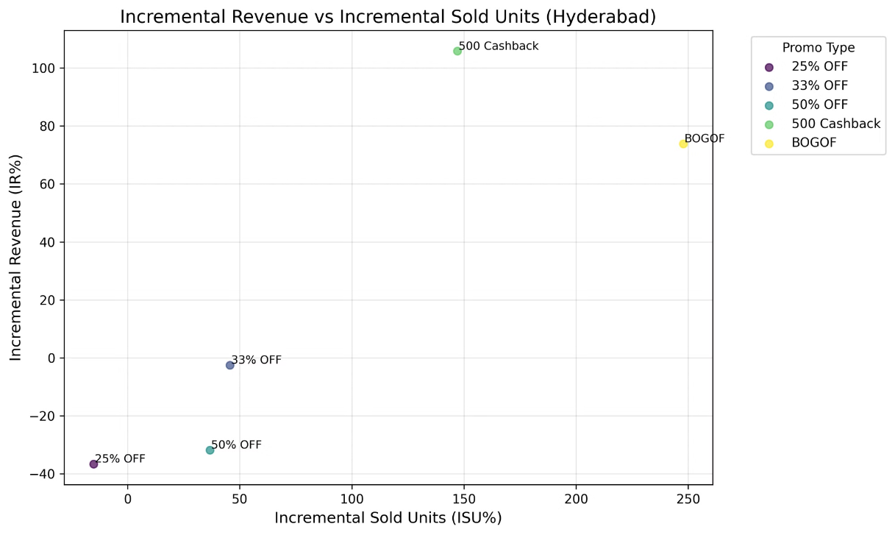


Promotion Type Comparison (Hyderabad)
BOGOF
Highest Sold Units
500 Cashback
Highest Revenue
BOGOF Impact
Cashback Impact
Highest increase in units sold, ideal for volume growth
Most profitable option, driving revenue growth

Slide 10
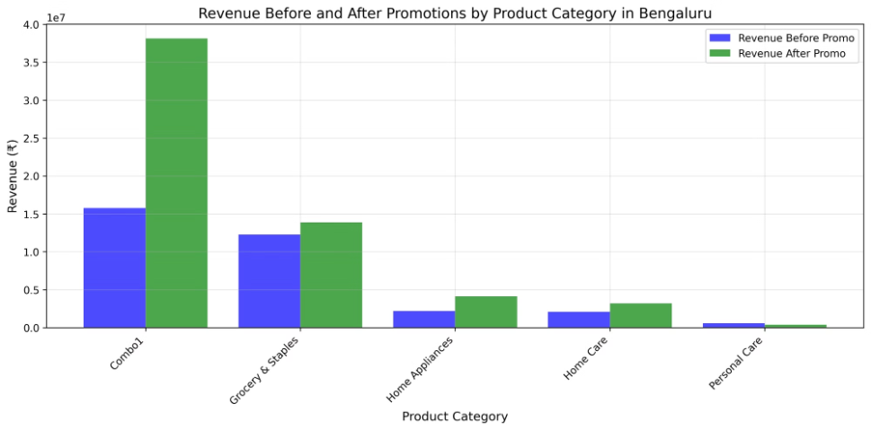
Bengaluru: Revenue Before & After Promotion

Slide 11
Bengaluru: Revenue Growth Before & After
Grocery & Staples
Home Care & Personal Care
Significant revenue uplift, indicating successful promotion
Moderate improvement, potential for further optimization

Slide 12

Key Takeaways & Next Steps
1
2
Grocery & Staples
Customized Strategies
Strong performer, prioritize
Target cities with lower impact
3
Promotion Optimization
Analyze individual promotion types

Slide 13
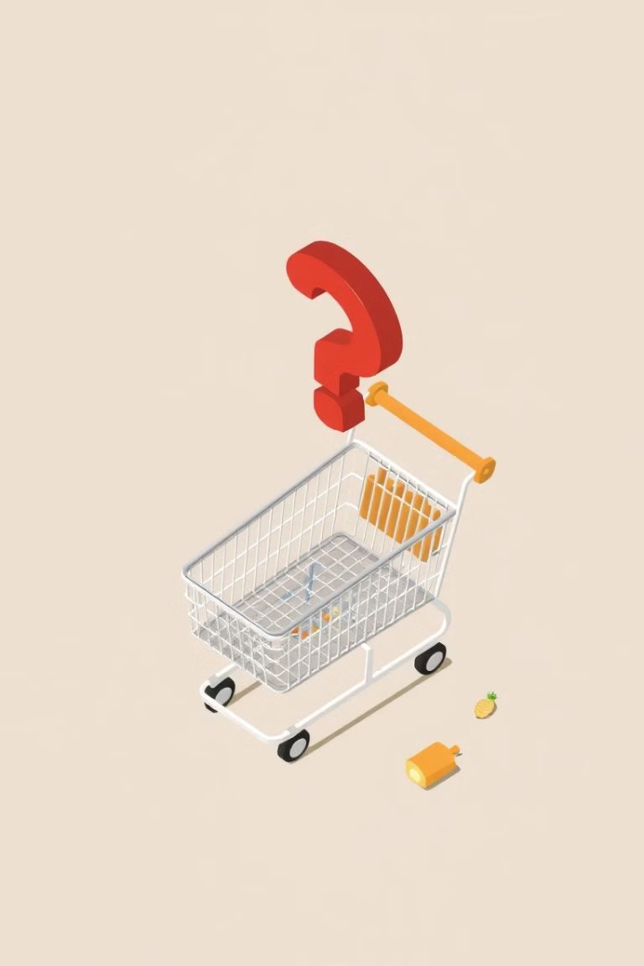
Areas for Improvement
City-Level Analysis
Category Optimization
Tailor strategies for cities with lower growth
Enhance performance of underperforming categories

Slide 14

Future Campaign Recommendations
1
Data-Driven Strategy
2
Category-Specific Offers
Leverage insights for personalized recommendations
Promote relevant products based on consumer preferences

Slide 15
Conclusion
The insights from this analysis will guide Nova Mart in crafting more effective and impactful promotional campaigns for future festivals, driving sales and customer engagement.

